Slide 1
The effects of sleep deprivation on reaction time
Tutorial group 1
Statistical Methods for Bioinformatics

Slide 2
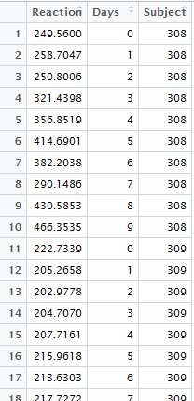
A first look at the data
18 truck drivers
Reaction time measured over 10 successive days of sleep deprivation
No control group
We want to model the changes between and within subjects => multi level model
Notes:
The margin of error for the tool used to measure the response time of the subjects is unknown.
The researchers tried to eliminate this by taking the mean of multiple measurements

Slide 3
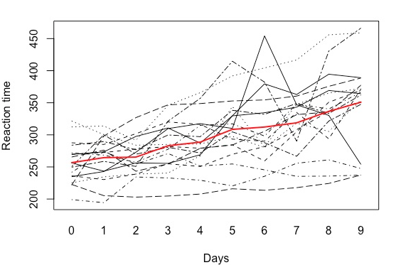
Let’s explore the data .. Global trends
Notes:
Sphagetti plot for change of reaction time with days for 16 truck drivers. The red line which denotes mean indicates that on average reaction time increasing when the number of days a truck driver has been sleep deprived increases. So the question arises is there a linear relationship between number of sleep deprived days and reaction time?

Slide 4
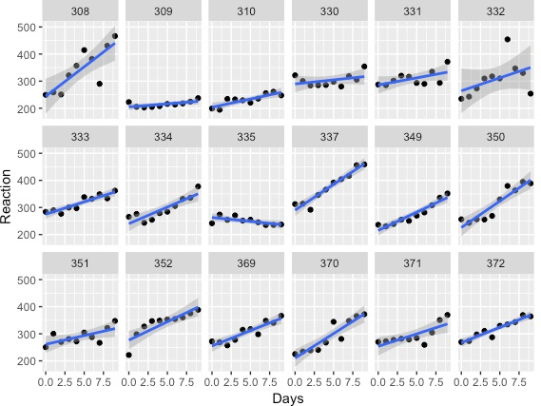
Let’s explore the data … finding a fit for each trucker
There seems to be a linear relationship between number of sleep deprived days and the reaction time of truck drivers.
1 outlier trucker (decreasing reaction time)
3 outlier datapoints
No apparent pattern in the residual errors
Notes:
Plot for each driver of how reaction time increases with number of sleep deprived days seems to suggest so. There is generally an increasing trend except for driver no 335 who may be an outlier or possibly some other factor that is not part of the study is influencing driver no 335

Slide 5
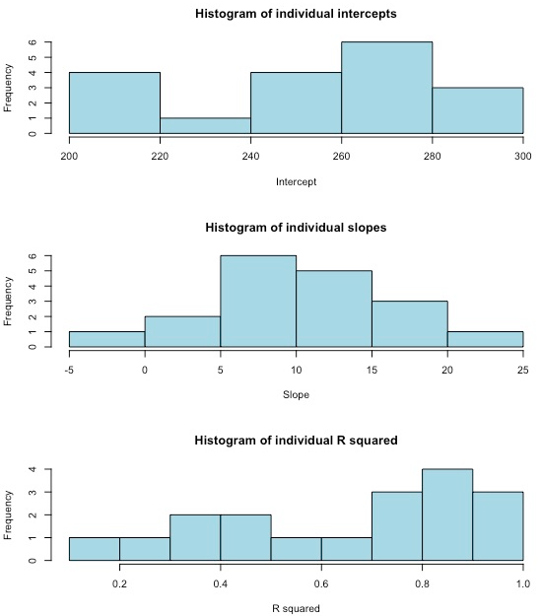
Let’s explore the data … intercept, slope, goodness of fit
Linear fit for each trucker seems to be OK
Notable differences between truckers, and those differences are more or less normally distributed
Notes:
Distribution of the intercept (upper)
Distribution of slopes (middle)
R² goodness of fit value (bottom)
A wide variety of values for the intrinsic response and daily rate of change in reaction time between subjects is observed
11 individual regressions have R² value of 0.6 or higher suggesting a linear relationship between reaction time and days of sleep deprivation.

Slide 6
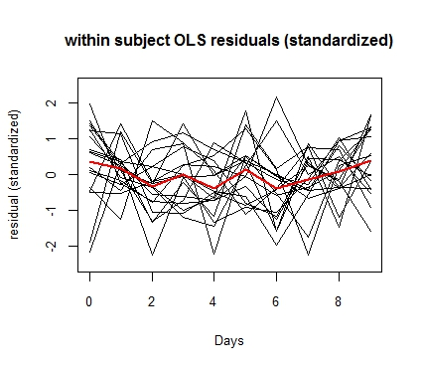
Let’s explore the data … the residuals
The residual errors show no apparent trend over time. => We can assume 1 error variance within each trucker

Slide 7
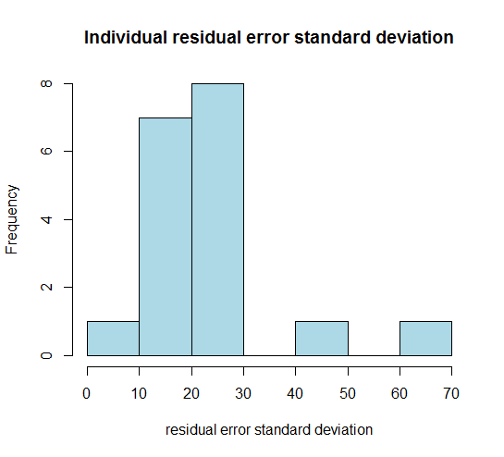
Let’s explore the data … the residuals
No need for separate error variance between truckers
(the 2 outlier values are caused by the 3 outlier data points)

Slide 8
Stating our assumptions
We want to model the differences within and between truckers => we go for a 2-level model (hierarchical model)
A linear model is a good fit for each trucker separately (level 1)
We allow the truckers to have their own initial reaction time, and their own respons to sleep deprivation (=2 random effects = level 2)
We assume 1 residual error variance for the entire model

Slide 9

The proposed hierarchical model
Hierarchical model
$\left\{\begin{aligned}Y_{ij}= π_{0i}+ π_{1i}\left(Days\right)+ ε_{ij} \\ π_{0i}= γ_{0}+b_{0i} \\ π_{1i}= γ_{1}+b_{0i}\end{aligned}\right.$
Distributional assumptions
$\left\{\begin{aligned}ε_{ij}\sim N(0,σ_{ε}^{2}) \\ \left({b_{0i} \atop b_{1i}}\right)\sim N\left(\left({0 \atop 0}\right),\left({σ_{0}^{2} { σ}_{01}^{ } \atop σ_{01}^{ } σ_{1}^{2}}\right)\right)\end{aligned}\right.$
Notes:
Our main null hypothesis is gamma 1 = 0

Slide 10

Fitting the model to the data
Hierarchical model
$\left\{\begin{aligned}Y_{ij}= π_{0i}+ π_{1i}\left(Days\right)+ ε_{ij} \\ π_{0i}=251.04+b_{0i} \\ π_{1i}=10.47+b_{0i}\end{aligned}\right.$
Distributional assumptions
$\left\{\begin{aligned}ε_{ij}\sim N(0,654.94) \\ \left({b_{0i} \atop b_{1i}}\right)\sim N\left(\left({0 \atop 0}\right),\left({612.09 10.26 \atop 10.26 35.07}\right)\right)\end{aligned}\right.$
Notes:
We used REML, lmer function
It is the marginal model that R fits
The correlation coefficient between intercept and slope = 0.07

Slide 11
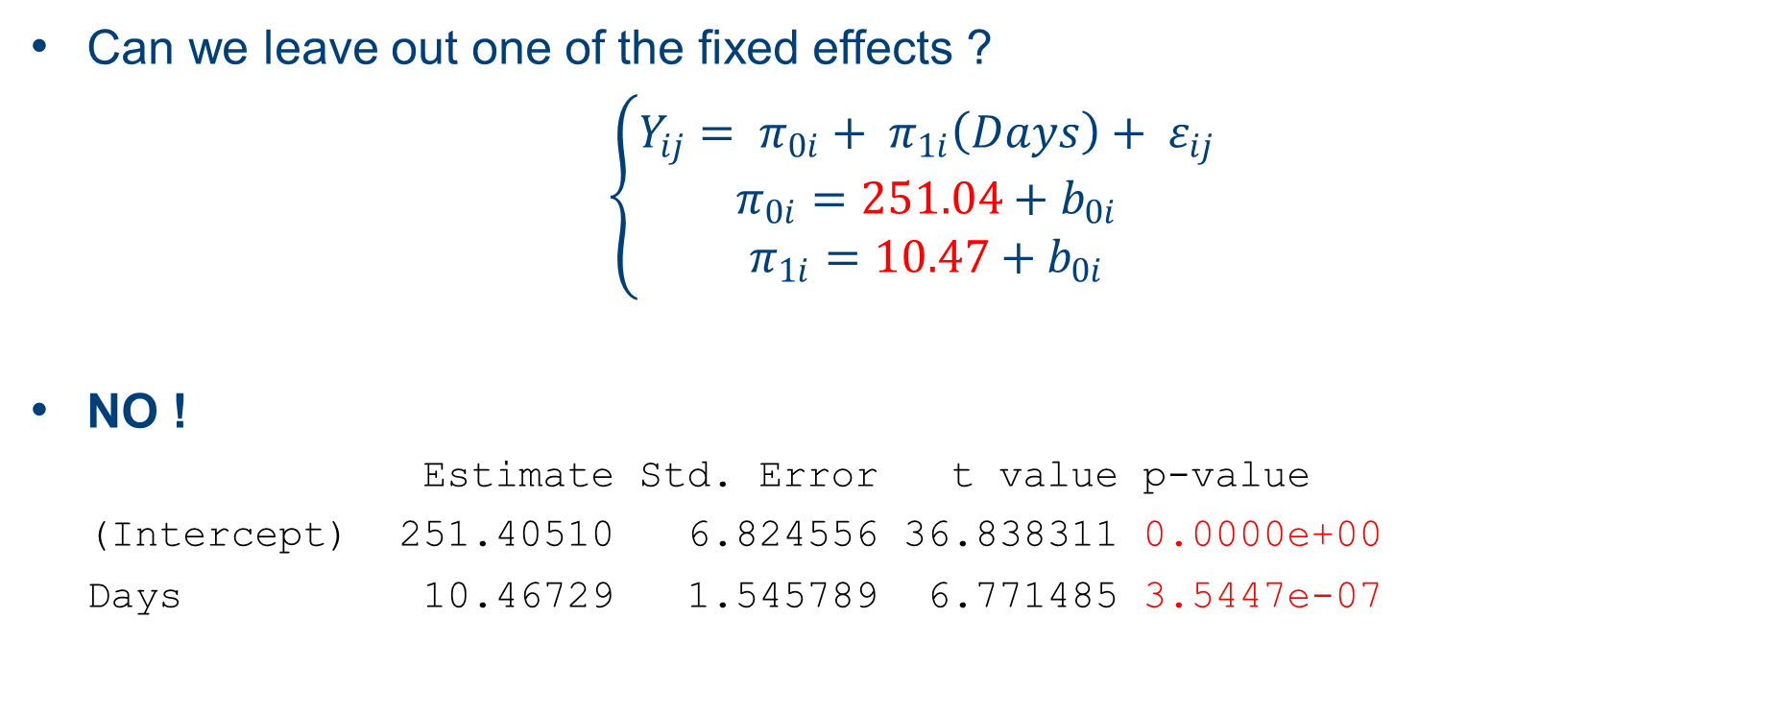
Simplify ? Inference for the FIXED effects (β)
Can we leave out one of the fixed effects ?
$\left\{\begin{aligned}Y_{ij}= π_{0i}+ π_{1i}\left(Days\right)+ ε_{ij} \\ π_{0i}=251.04+b_{0i} \\ π_{1i}=10.47+b_{0i}\end{aligned}\right.$
NO !
Estimate Std. Error t value p-value
(Intercept) 251.40510 6.824556 36.838311 0.0000e+00
Days 10.46729 1.545789 6.771485 3.5447e-07
Notes:
The fixed effect estimation is distributed according to a t-distribution
The degrees of freedom for this t distribution are estimated via a Kenward and Roger approximation

Slide 12
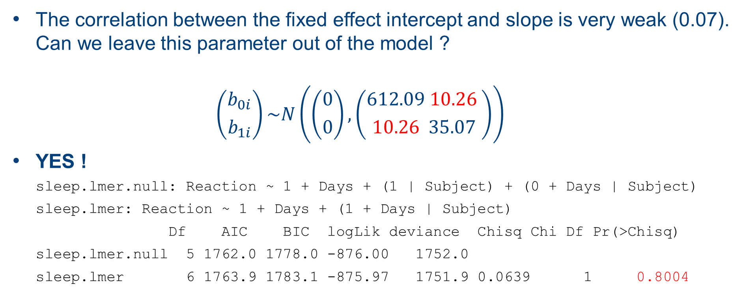
Simplify ? Inference for the VARIANCE components(α)
The correlation between the fixed effect intercept and slope is very weak (0.07). Can we leave this parameter out of the model ?
$$\left({b_{0i} \atop b_{1i}}\right)\sim N\left(\left({0 \atop 0}\right),\left({612.09 10.26 \atop 10.26 35.07}\right)\right)$$
YES !
sleep.lmer.null: Reaction ~ 1 + Days + (1 | Subject) + (0 + Days | Subject)
sleep.lmer: Reaction ~ 1 + Days + (1 + Days | Subject)
Df AIC BIC logLik deviance Chisq Chi Df Pr(>Chisq)
sleep.lmer.null 5 1762.0 1778.0 -876.00 1752.0
sleep.lmer 6 1763.9 1783.1 -875.97 1751.9 0.0639 1 0.8004
Notes:
The high chi-square p value indicates that the null-hypothesis can not be rejected. This means we can go for the smaller model, the one without the covariance. We might have initially guessed that truckers that start with a high reaction time would have a slower rise in their reaction time as compared to the truckers that start with a very low reaction time (a natural tendency for responses to regress to the mean). This would imply a negative correlation. But in fact we see no effect of this kind.

Slide 13
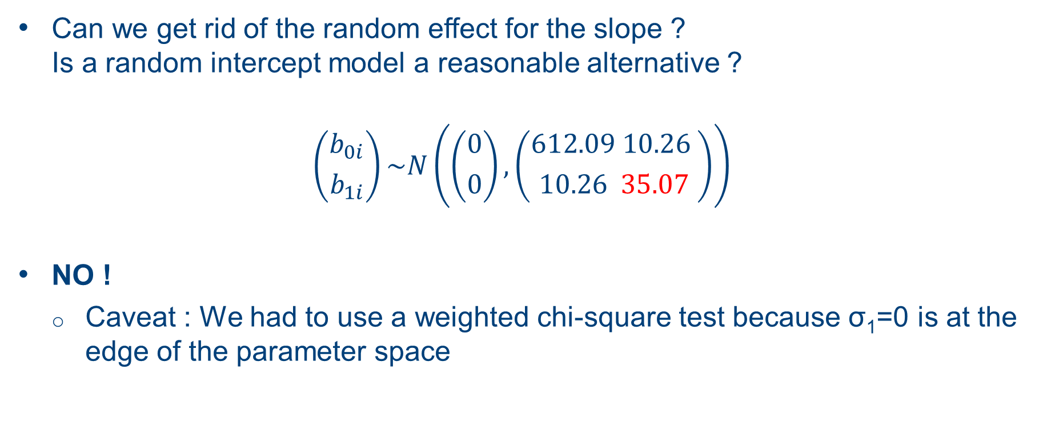
Simplify ? Inference for the VARIANCE components(α)
Can we get rid of the random effect for the slope ? Is a random intercept model a reasonable alternative ?
$$\left({b_{0i} \atop b_{1i}}\right)\sim N\left(\left({0 \atop 0}\right),\left({612.09 10.26 \atop 10.26 35.07}\right)\right)$$
NO !
Caveat : We had to use a weighted chi-square test because σ₁=0 is at the edge of the parameter space
Notes:
We keep sigma_1 in our model and by doing so allow the truckers to have their own individual respons to sleepdeprivation.

Slide 14
Assessing the random effects (shrinkage)
Before concluding, it’s interesting to see how our hierarchical model differs from using plain linear regression on every trucker individually
Using our final model we estimate the random effects for every trucker in our dataset (the b’s)
We see the ‘shrinkage effect‘
the intercept and slope we estimate via LMM lie closer to the population average.

Slide 15
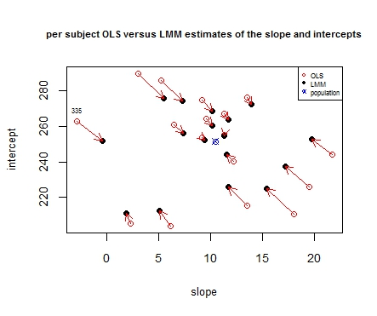
Assessing the random effects (shrinkage)

Slide 16

Our final model !
Hierarchical model
$\left\{\begin{aligned}Y_{ij}= π_{0i}+ π_{1i}\left(Days\right)+ ε_{ij} \\ π_{0i}=251.04+b_{0i} \\ π_{1i}=10.47+b_{0i}\end{aligned}\right.$
Distributional assumptions
$$\left\{\begin{aligned}ε_{ij}\sim N({0,25.56}^{2}) \\ b_{0i}\sim N({0,25.05}^{2}) \\ b_{1i}\sim N({0,5.99}^{2})\end{aligned}\right.$$
Notes:
Our main null hypothesis is gamma 1 = 0

Slide 17
Conclusions
the reaction time is expected to go up by 10.47 ms for every day of sleep deprivation (for first 10 days at least). This can vary per subject (sd =6ms)
The expected reaction time for a subject with no sleepdeprivation is 251ms. This can vary per subject (sd = 25ms)
Caveats !
No control group ! Compelling evidence but not definitive..
Truckers are not representative for the whole population
Notes:
Our main null hypothesis is gamma 1 = 0

